Slide 1

ML 23/24-05 Implement the visualization of permanence value
Team: Team.bji
Bidhan Paul
Md Imon Bhuiya
Md Jamal Uddin

Slide 2

Objective
The objective of this study is to investigate the reconstruction of Input in Hierarchical Temporal Memory (HTM) networks using the Neocortex API's Reconstruct method. Specifically, the study aims to: Reconstruction Method in NeoCortexApi
Running Reconstruction
Visualize Permanence Values
Similarity Calculation between Original Encoded inputs and Reconstructed Input

Slide 3

Introduction
HTM
Encoder
Spatial Pooler
Reconstruction

Slide 4
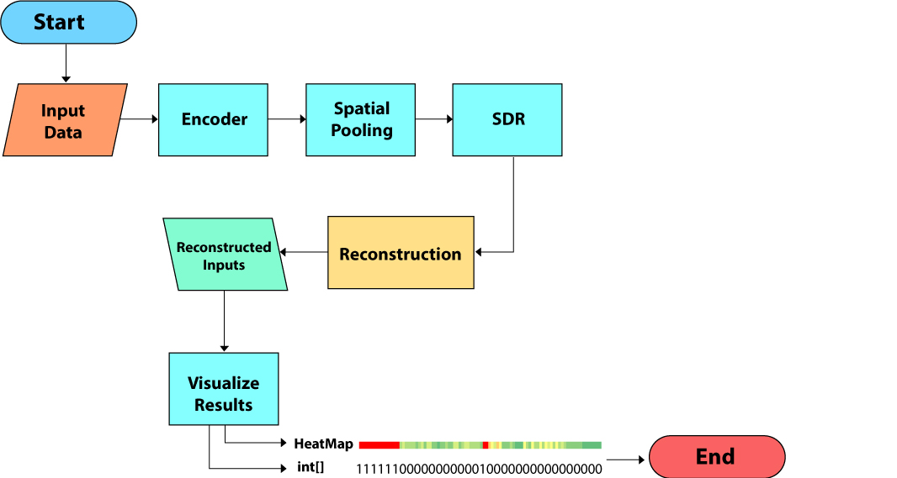
Methodology

Slide 5
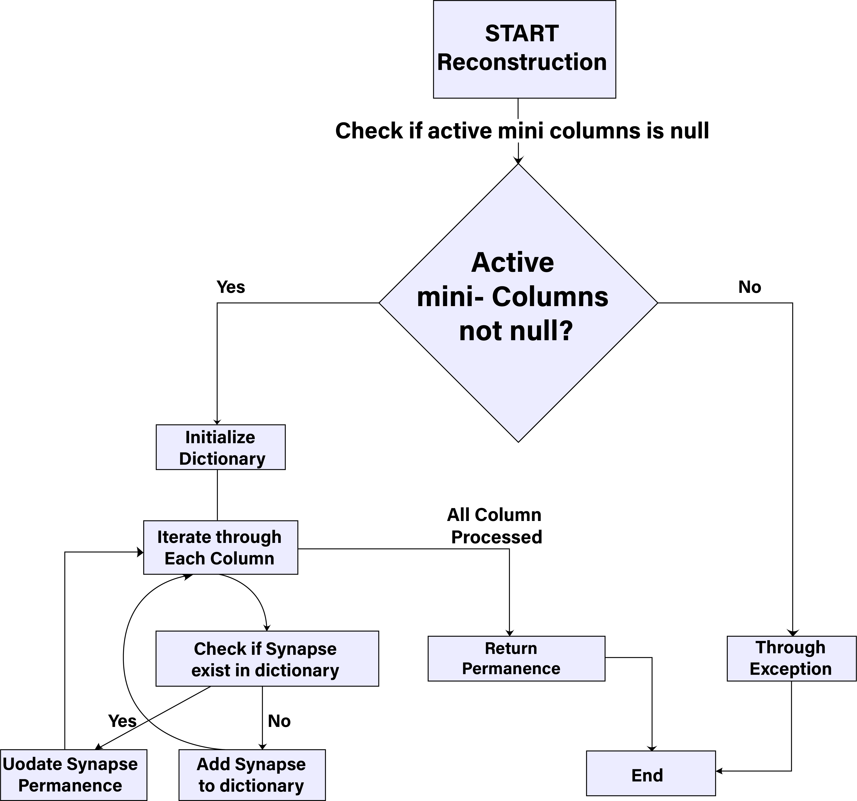
Reconstruction Method in NeoCortexApi

Slide 6
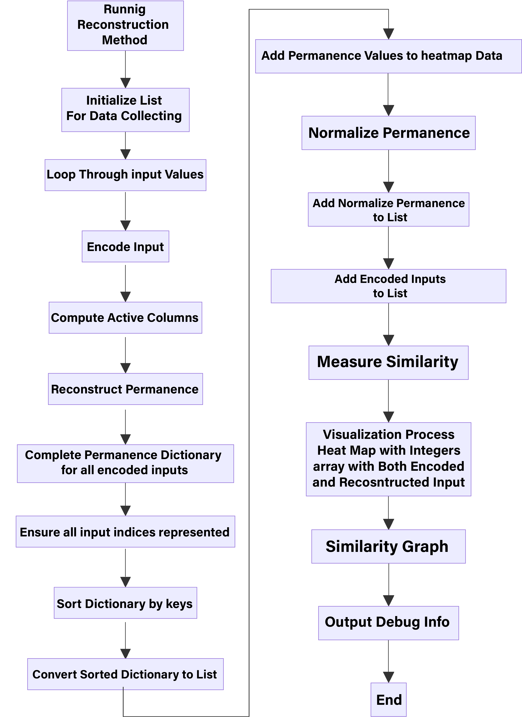
Input Reconstruction with Reconstruction Method

Slide 7
Visualization Technique of the Permanence Values
Heatmap with the Permanence Values
Normalization of Permanence values with Threshold
Encoded Input to Compare between original and Reconstructed
Similarity

Slide 8
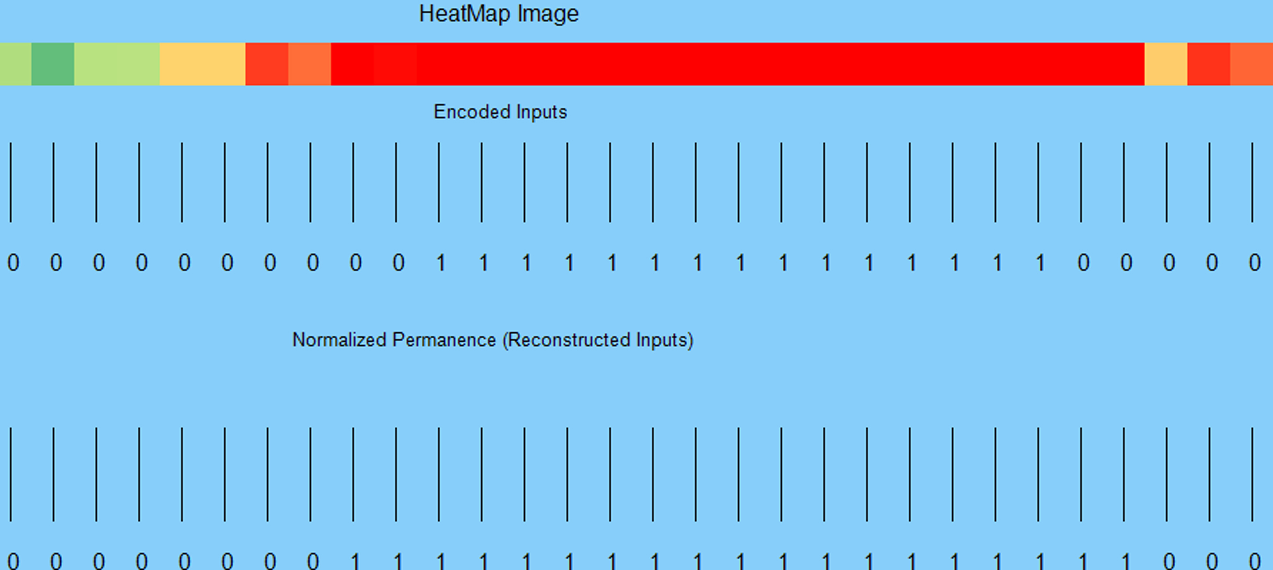
Visualization Result
HeatMap

Slide 9
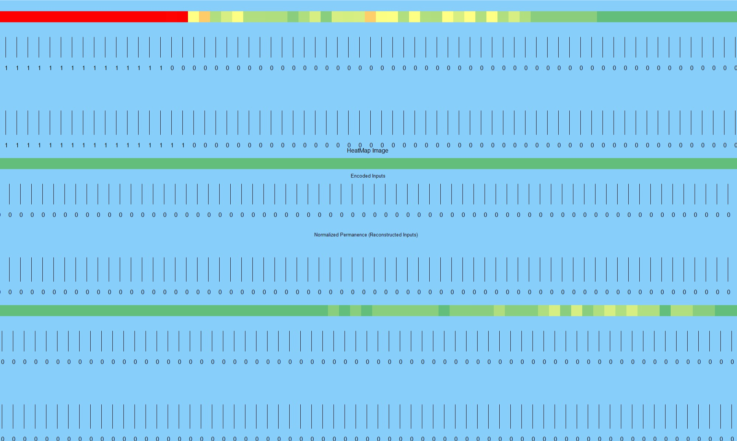
Comparing With Original and Reconstructed

Slide 10
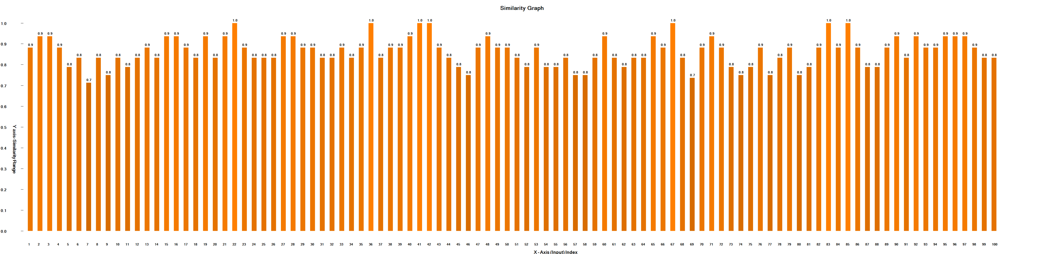
Validation of Result using Similarity Check

Slide 11
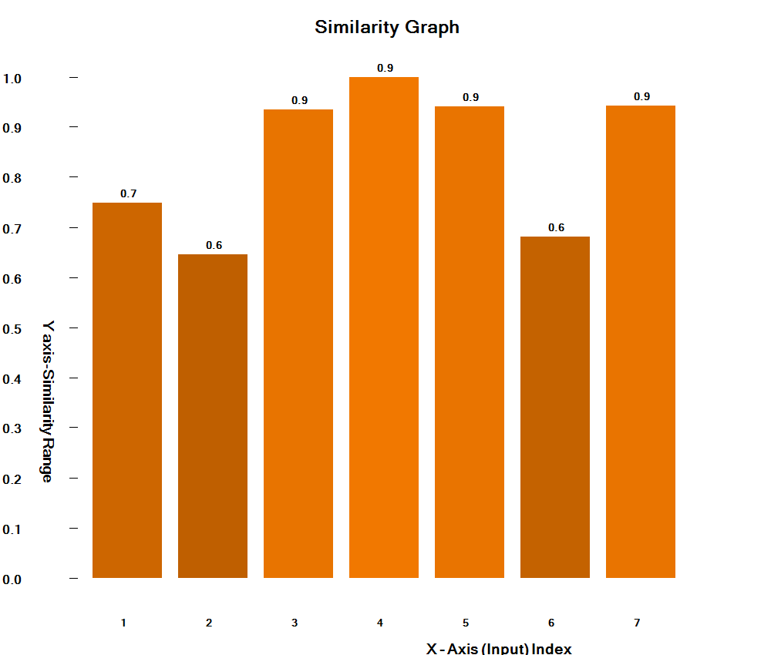
Similarity for Image Inputs

Slide 12
Conclusion
Reconstruction of Inputs
For Two Types Numerical Inputs and Image Inputs
Unit Test of the Reconstruction Method
Some presumption regarding the Reconstruction of Inputs

Slide 13
Thank you!

